Slide 1
Sensory Marketing and the Subtle Science of Packaging
David Frank
MSc Marketing, Edinburgh Napier University, Scotland Dip. Business, Central TAFE, Australia
thedavidfrank.com/talks
@TheDF

Slide 2
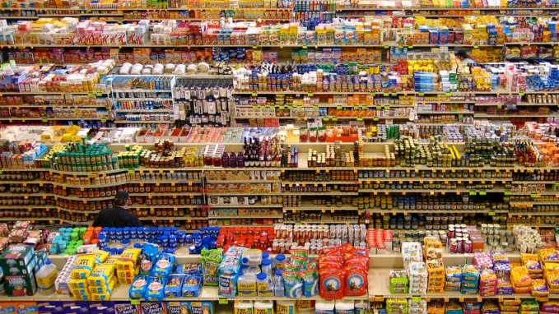
The Paradox of Choice by Barry Schwartz
285 varieties of cookies
230 soup offerings
75 instant gravies
120 pasta sauces
175 salad dressings
16 “Italian” dressings
275 varieties of cereal
24 oatmeal options
22 types of frozen waffles
7 “Cheerios” options

Slide 3
“There is too much going on to shape an objective reality”
- Rory Sutherland
brain shortcut
rule of thumb
heuristic
somatic marker

Slide 4
Color and Shape
…processing occur before any other cognition
Bordeaux, Burgundy, Riesling
Spence, Charles & Wang, Qian, 2015

Slide 5
Close your eyes….
Imagine…
The shape of a Gatorade bottle
Absolut Vodka bottle shape
The color, shape and feel of your shampoo bottle at home

Slide 6
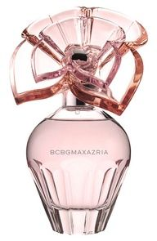
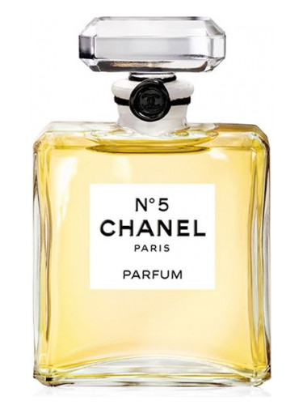
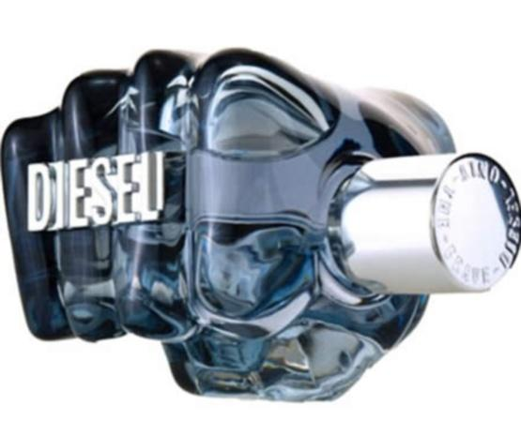
Shape + Material

Slide 7
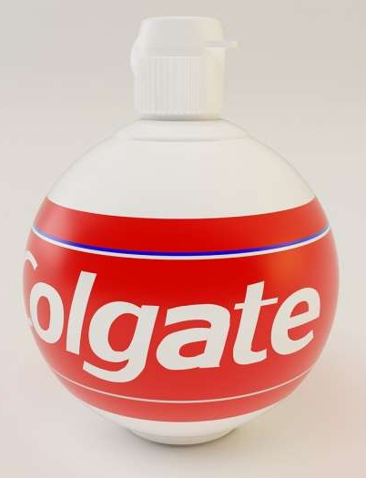
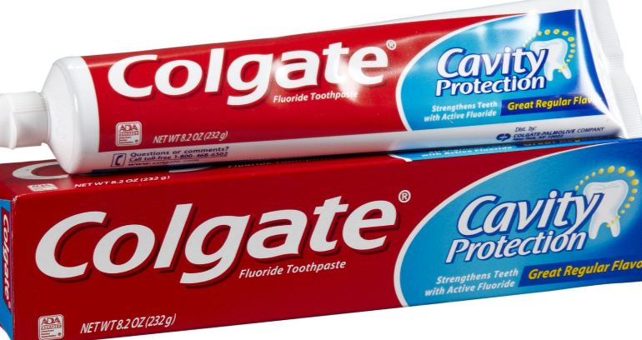
Category Cues: Packaging Type
toothpaste comes in…

Slide 8
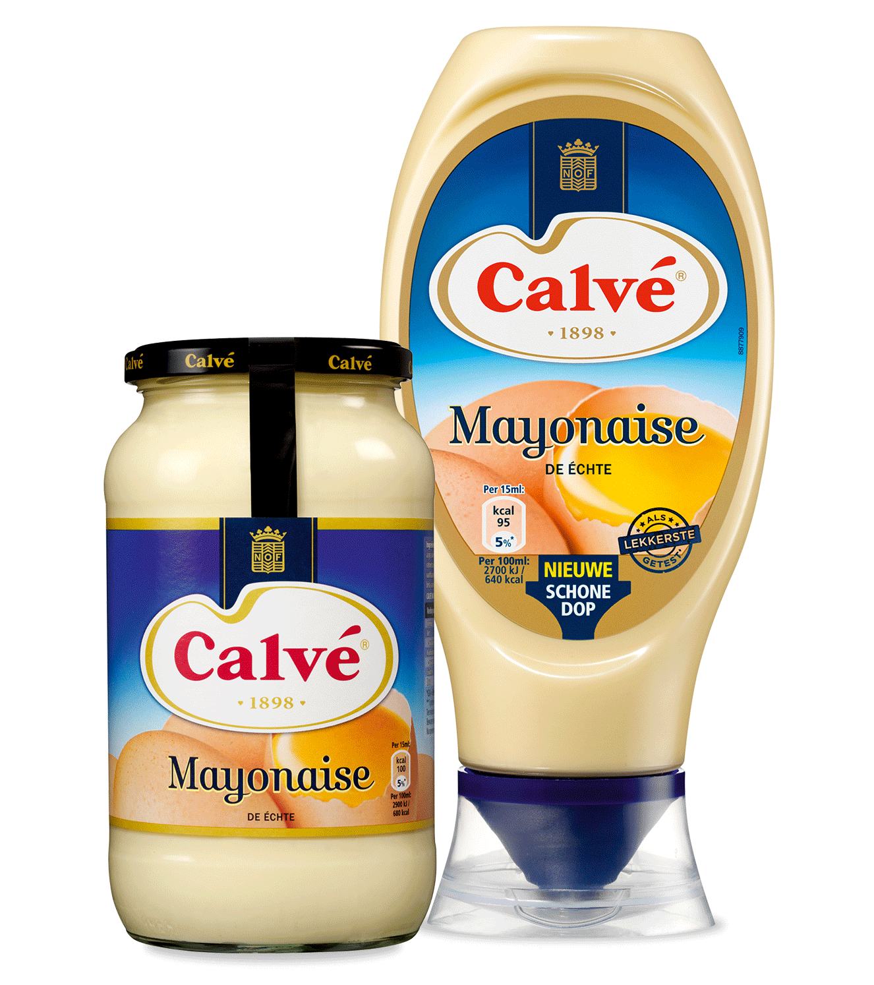
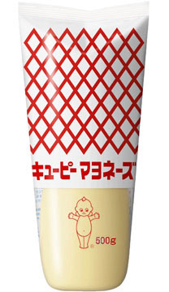
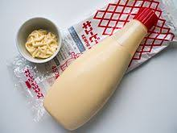
Category Cues: Packaging Type
toothpaste comes in…
mayonnaise comes in…

Slide 9
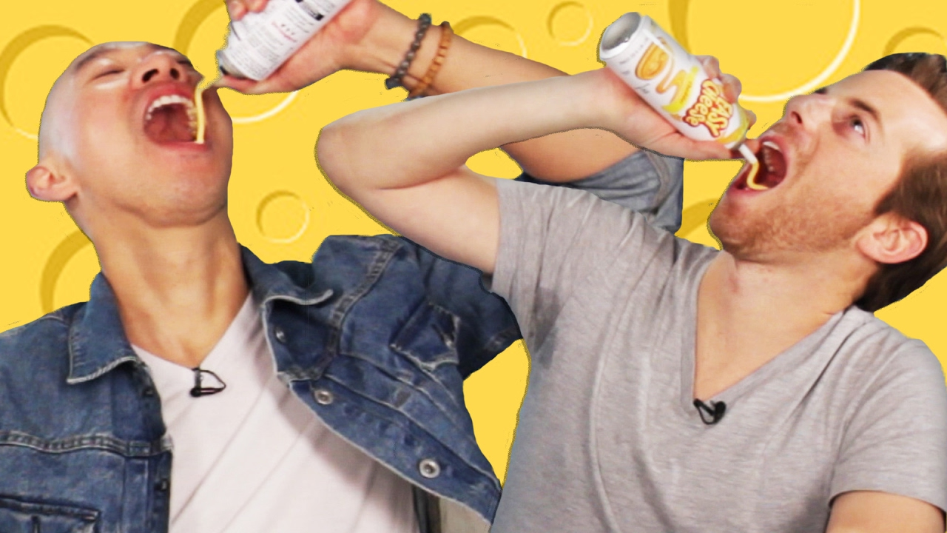
Category Cues: Packaging Type
toothpaste comes in…
mayonnaise comes in…
cheese comes in…

Slide 10
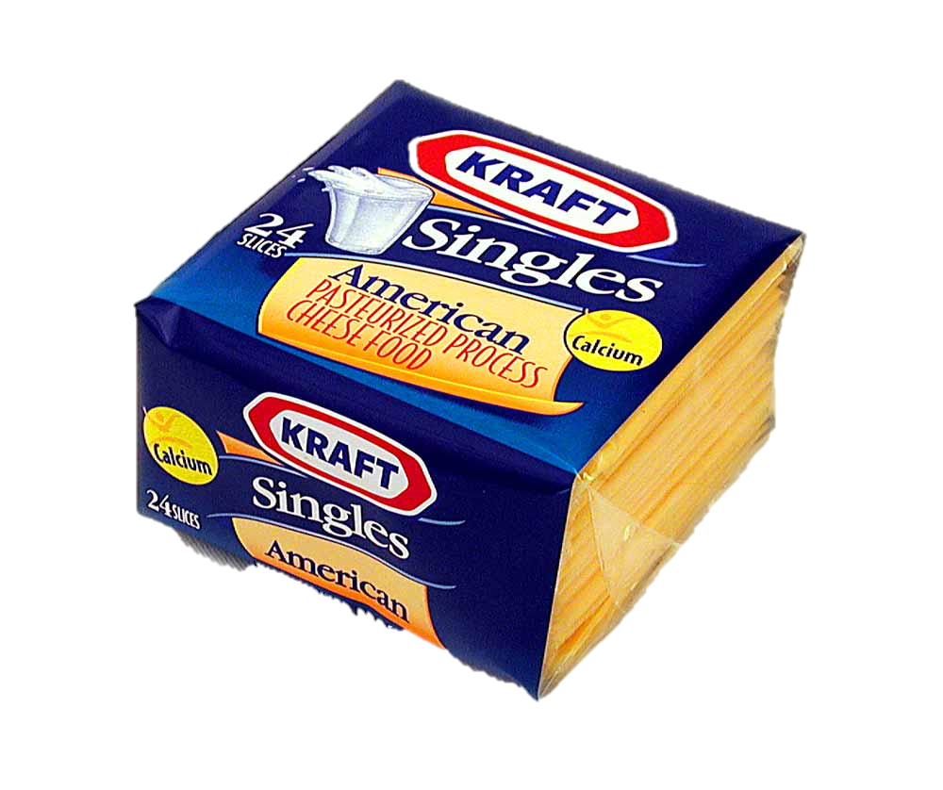
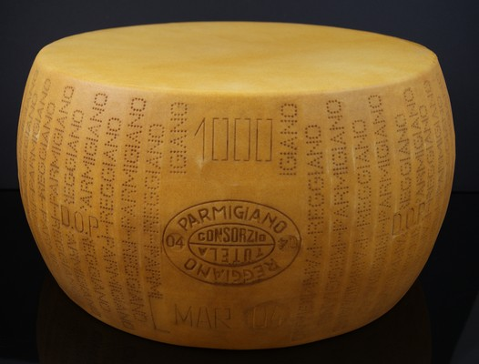
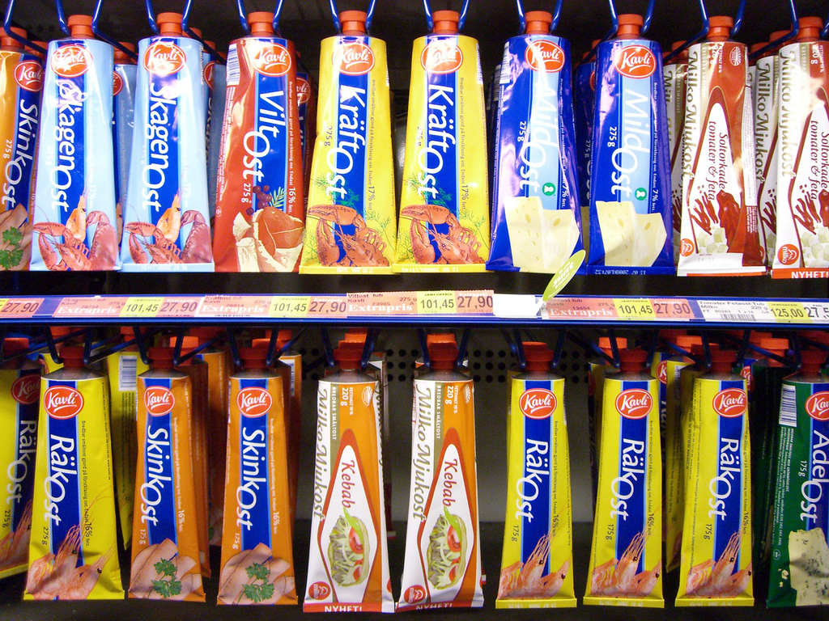
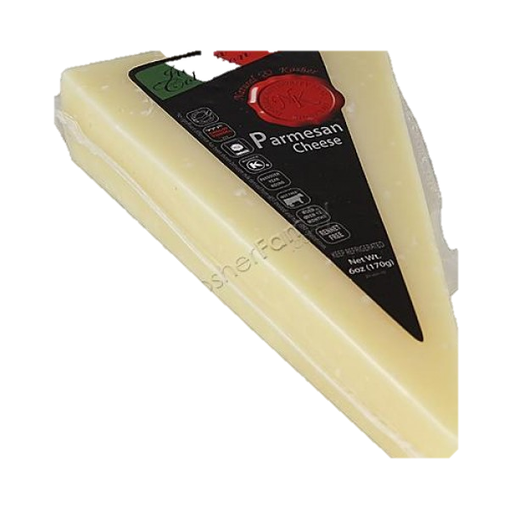
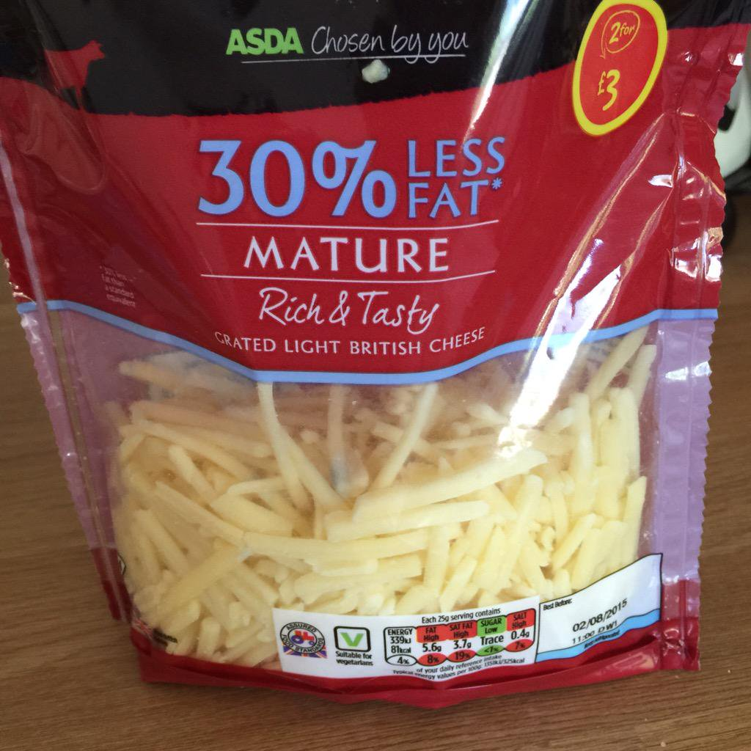
Category Cues: Packaging Type
toothpaste comes in…
mayonnaise comes in…
cheese comes in…

Slide 11
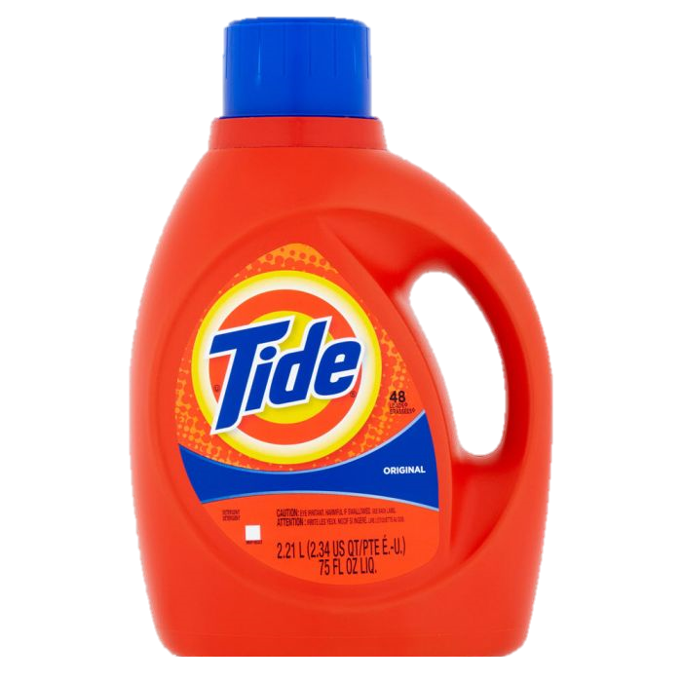
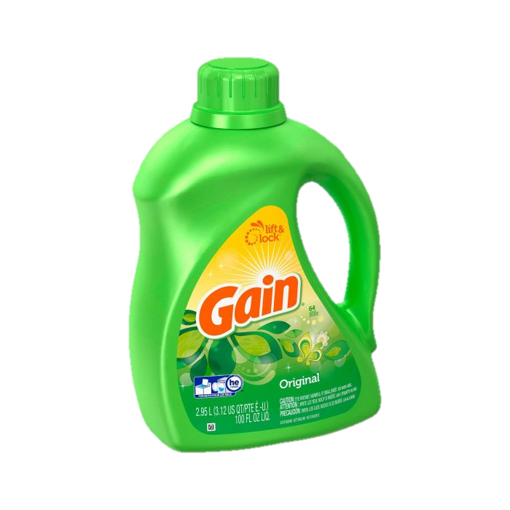
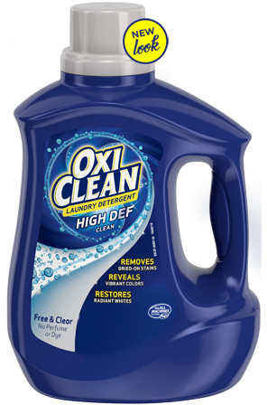
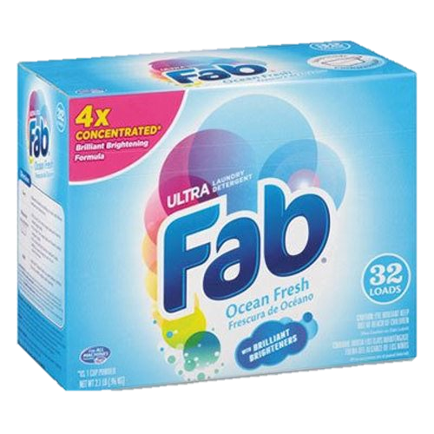
Close your eyes again, and imagine…
Large, brightly colored, bottle with lots of asymmetric curves
Background: bright blue, green or red
Big handle on one side
Brightly coloured text
Extra bold
Uppercase
Sans-serif italic font arranged diagonally
What product category am I?
Celhay & Trinquecoste, 2014

Slide 12
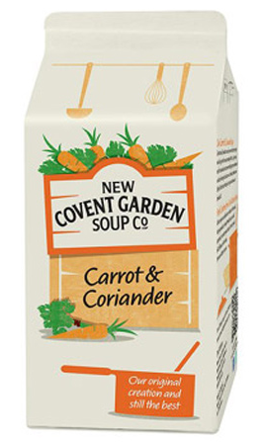
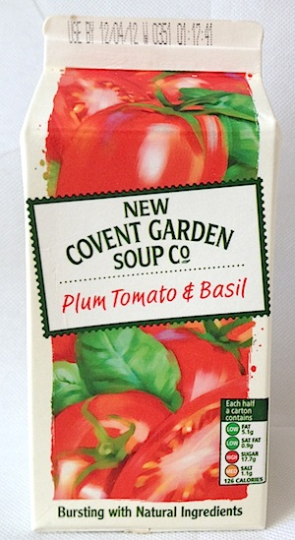
Borrow Associations
Gallace & Spence, 2014; Spence & Gallace, 2011

Slide 13
“99% pleasure. The rest is carton”
Spence & Gallace 2011, Cheskin (1957)

Slide 14
Bouba / Kiki effect
Neurotypical individuals: 88%
Köhler, W, 1929; Oberman LM & Ramachandran VS, 2008

Slide 15
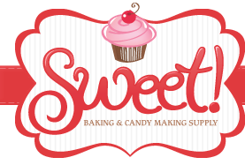
Shapes and typefaces taste…
Round
Low color saturation
Angular shapes
High color saturation
Velasco et al (2014) , Becker et al. (2011)

Slide 16
Symbolism in typefaces (fonts)

Slide 17
Neuroscience
Visual shape -> lateral occipital complex
Touch shape -> Lateral occipital tactile-visual region
Touch and visual processing are fundamentally integrated
Neural pathways overlap
Amedi, Jacobson, Hendler, Malach, & Zohary, (2002) Snow, Strother, & Humphreys, (2014)

Slide 18
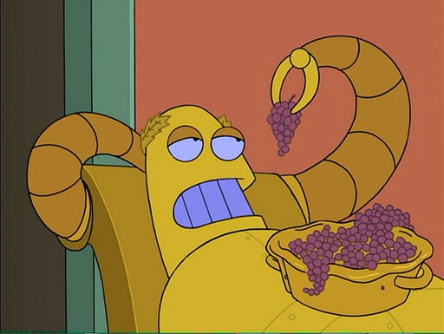
Touchy-feely people
Need-for-Touch scale (12 question survey)
“When walking through stores, I can’t help touching all kinds of products.”
Hedonic
Peck & Childers, 2003

Slide 19
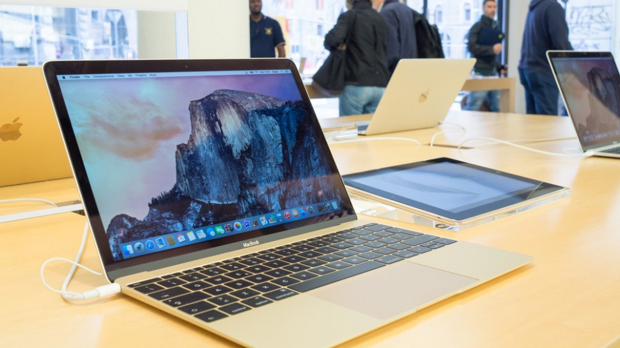
Touch
The Endowment Effect
Individuals value products more if they have touched it because they feel they are already endowed with / own it.
Garber, 2012; Gallo, 2012a, 2012b; Brasel & Gips, 2014; Kahneman, Knetsch, & Thaler, 1990; Krishna et al., 2017; Peck, Barger, & Webb, 2013; Peck & Shu, 2009; Peck & Childers, 2006; Peck & Shu, 2009

Slide 20
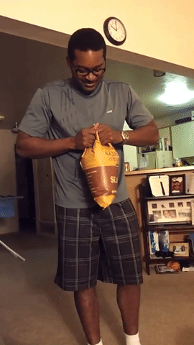
Q: Why are Kettle Chips so hard to open?
A: It makes them seem crunchier
McDaniel and Barker, 1977

Slide 21
Perceptual Transference
Difficulty Opening: Increases crunchiness
Texture roughness: Increases perceived crunchiness
Associated with ‘Natural’
Crackly sound Seems fresher and crunchier
Compressibility: Sturdy cups = better drink
Weight: Heavier = better – cups, batteries
Color saturation Increases juice flavor
Karana 2009

Slide 22
Embossment
‘Premium’ cue
Backfires when clashes with other cues
Helps grab attention
Especially if shiny
Karana 2009

Slide 23
Packaging affects your perception of products See if you can spot the cues
Download the slides: thedavidfrank.com/talks
@TheDF

Slide 24
References
Becker, L., van Rompay, T. J. L., Schifferstein, H. N. J., & Galetzka, M. (2011). Tough package, strong taste: The influence of packaging design on taste impressions and product evaluations. Food Quality and Preference, 22(1), 17–23.
Birch, D., & Lawley, M. (2012). Buying Seafood: Understanding barriers to purchase across consumption segments. Food Quality and Preference, 26(1), 12–21.
Celhay, F., & Trinquecoste, J. F. (2014). Package Graphic Design: Investigating the Variables that Moderate Consumer Response to Atypical Designs. Journal of Product Innovation Management, 32(6), 1014–1032.
Cheskin, L. (1957). How to predict what people will buy. New York: Liveright.
Heide, M., & Olsen, S. O. (2017). Influence of packaging attributes on consumer evaluation of fresh cod. Food Quality and Preference, 60, 9–18.
Karana, E., Hekkert, P., & Kandachar, P. (2009). Meanings of materials through sensorial properties and manufacturing processes. Materials and Design, 30(7), 2778–2784.
Köhler, W (1929). Gestalt Psychology. New York: Liveright.
Koo, J., & Suk, K. (2016). The effect of package shape on calorie estimation. International Journal of Research in Marketing, 33(4), 856–867.
Krishna, A., & Morrin, M. (2008). Does Touch Affect Taste? The Perceptual Transfer of Product Container Haptic Cues. Journal of Consumer Research, 34(6), 807–818.
McDaniel, C., & Baker, R. C. (1977). Convenience Food Packaging and the Perception of Product Quality: What does “hard-to-open” mean to consumers? Journal of Marketing, 41(4), 57–58.
Oberman LM & Ramachandran VS (2008). "Preliminary evidence for deficits in multisensory integration in autism spectrum disorders". Social Neuroscience. 3 (3-4): 348–55
Olsen, S. O., Scholderer, J., Brunsø, K., & Verbeke, W. (2007). Exploring the relationship between convenience and fish consumption. Appetite, 49(1), 84–91.
Peck, J., & Childers, T. L. (2003). Individual Differences in Haptic Information Processing: The “Need for Touch” Scale. Journal of Consumer Research, 30(3), 430–442.
Spence, C., & Gallace, A. (2011). Multisensory design: Reaching out to touch the consumer. Psychology and Marketing, 28(3), 267–308.
Spence, C., & Wang, Q. (2015). Sensory expectations elicited by the sounds of opening the packaging and pouring a beverage. Flavour, 4(1), 35.
Velasco, C., Salgado-Montejo, A., Marmolejo-Ramos, F., & Spence, C. (2014). Predictive packaging design: Tasting shapes, typefaces, names, and sounds. Food Quality and Preference, 34.

